Slide 1
Applied Physics
Unit 2: Semiconductor Physics
Dr. G. Patrick

Slide 2
Unit 2: Semiconductor Physics
Intrinsic and extrinsic semiconductors, Estimation of carrier concentration, Dependence of Fermi level on carrier concentration and variation with temperature, Carrier transport: diffusion and drift, Hall Effect, p-n junction diode: I-V Characteristics, Zener diode: I-V Characteristics, Bipolar Junction Transistor (BJT): Construction and principle of operation (n-p-n and p-n-p) in common base configuration.

Slide 3
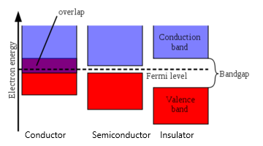
Conductors, Semiconductors and Insulators

Slide 4
Semiconductors
Semiconductors are materials having electrical conductivity greater than that of insulators but less than that of conductors.
Semiconductors may be classified as
Intrinsic semiconductor or
Extrinsic semiconductor

Slide 5
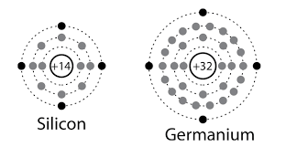
Intrinsic semiconductor
Chemically pure semiconductors are called as intrinsic semiconductors.
Germanium and silicon are intrinsic semiconductors having 4 valence electrons.
At 0 K all the electrons are in the valence band held by covalent bonding and the material behaves as an insulator at 0 K.

Slide 6
Extrinsic semiconductor
A semiconductor doped with impurity atoms is called extrinsic semiconductor.
Extrinsic semiconductors may be n type or p type depending on the dopent.
n type extrinsic semiconductors are formed when a intrinsic semiconductor is doped with Group V elements like phosphorous, arsenic, antimony etc.
p type extrinsic semiconductors are formed when a intrinsic semiconductor is doped with Group III elements like aluminium, boron, gallium etc.

Slide 7
Intrinsic vs Extrinsic semiconductor
BASIS OF DIFFERENCE | INTRINSIC SEMICONDUCTOR | EXTRINSIC SEMICONDUCTOR
Doping of impurity | Doping or addition of impurity does not take place in intrinsic semiconductor. | A small amount of impurity is added to a pure semiconductor for preparing extrinsic semiconductor. For n type, Group V elements are added and for p type Group III elements are added.
Density of electrons and holes | The number of free electrons in the conduction band is equal to the number of holes in the valence band. | The number of electrons and holes are not equal. In n type electrons are in majority and in p type holes are in majority.
Electrical conductivity | Electrical conductivity is low. | Electrical conductivity is high
Dependency of electrical conductivity | Electrical conductivity is a function of temperature alone. | Electrical conductivity depends on temperature as well as on the amount of impurity added to the pure semiconductor.
Fermi level | Fermi level is in the middle of forbidden gap. | n type: Fermi level is near conduction band. P type: Fermi level is near valence band.

Slide 8
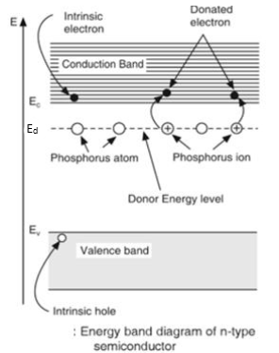
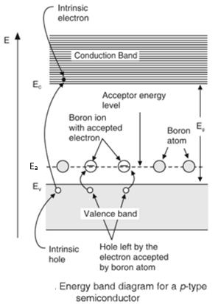
Energy level diagram
n type
P type

Slide 9
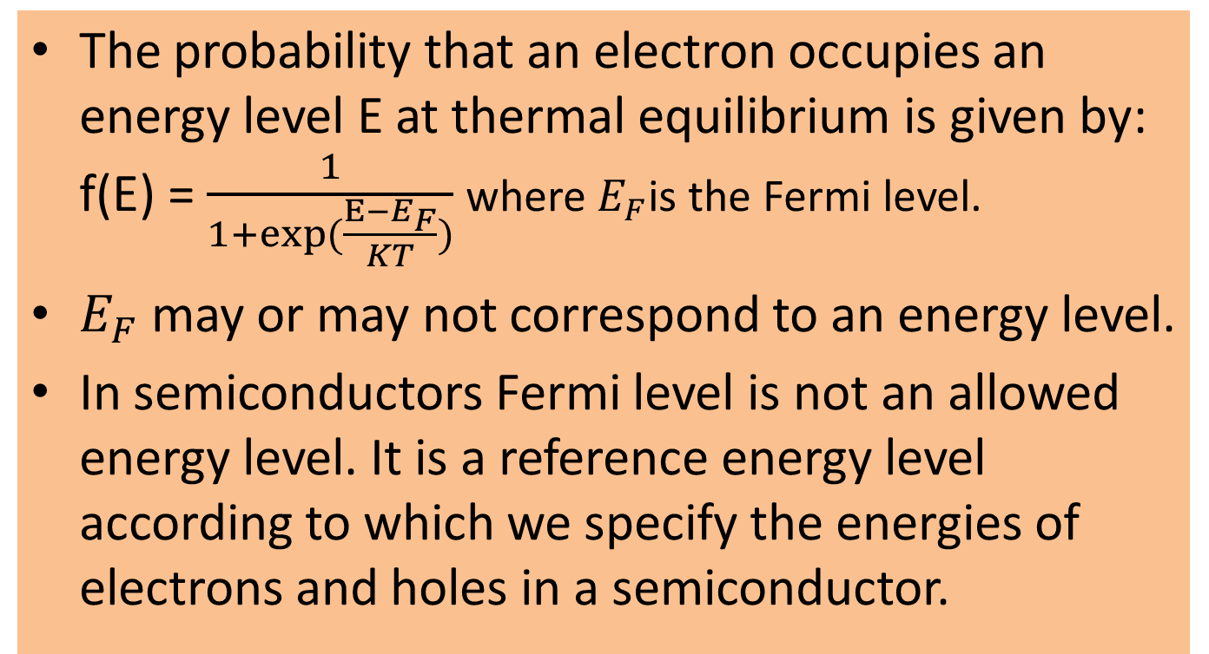
Fermi-Dirac distribution function and Fermi level

Slide 10
Fermi Level
Fermi energy is defined as maximum energy that a free electron can have in a conductor at 0 K.
Fermi energy is the energy of the state at which the probability of electron occupation is half i.e. 0.5 at any temperature above 0 K.

Slide 11
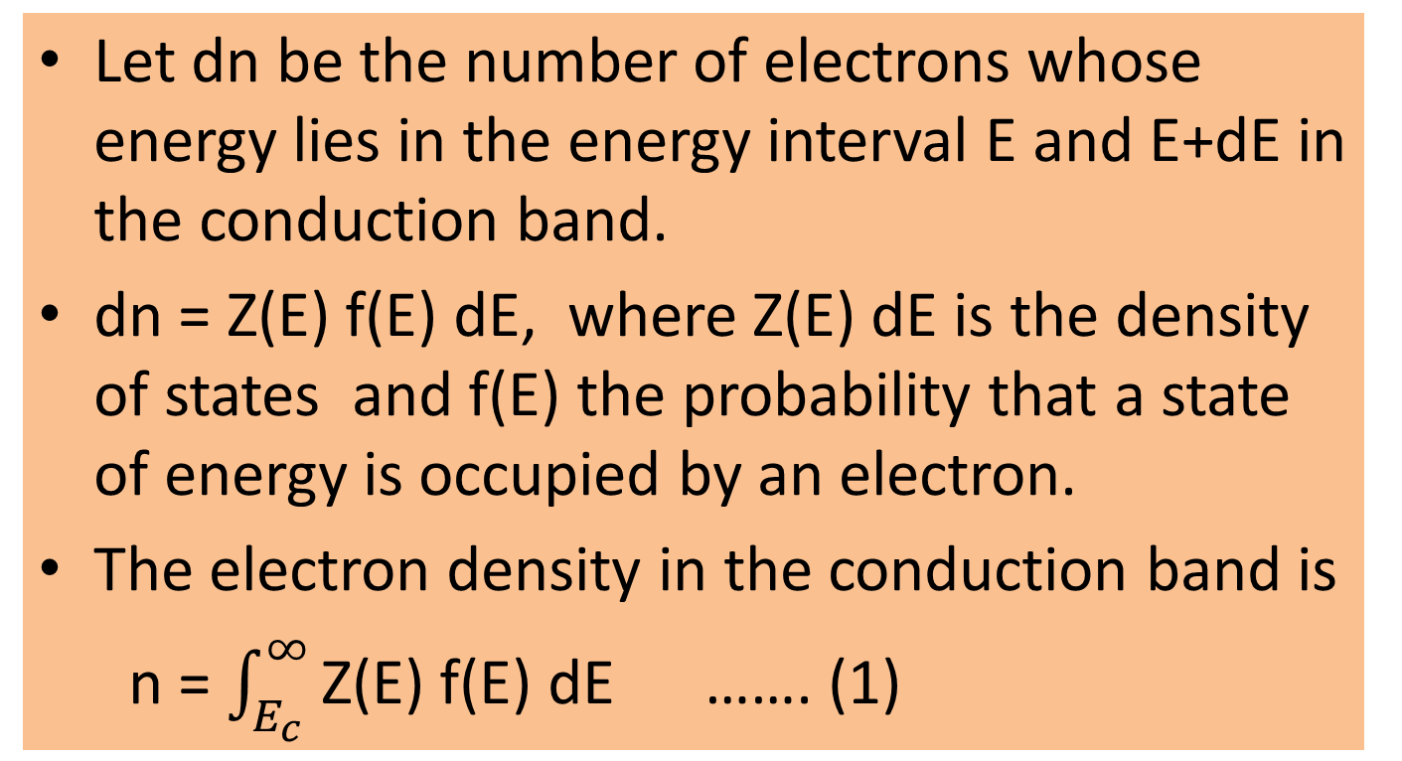
Intrinsic Semiconductor
Calculation of electron density

Slide 12
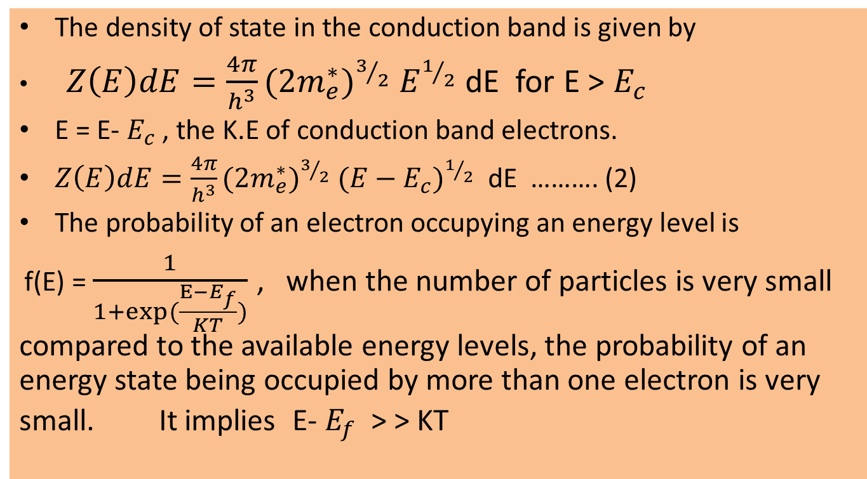
Intrinsic Semiconductor
Calculation of electron density

Slide 13
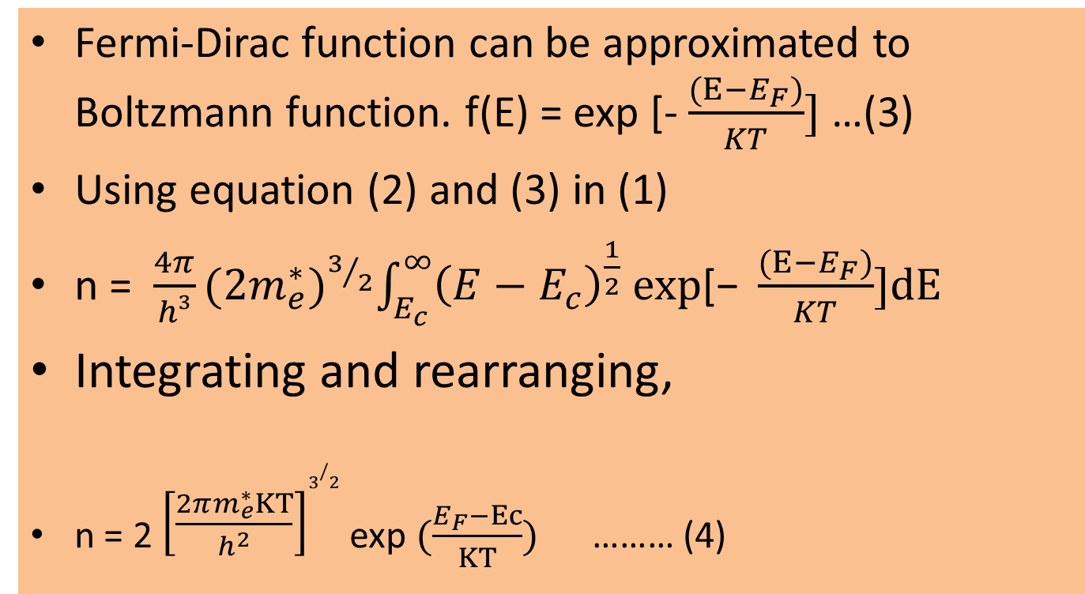
Intrinsic Semiconductor
Calculation of electron density

Slide 14
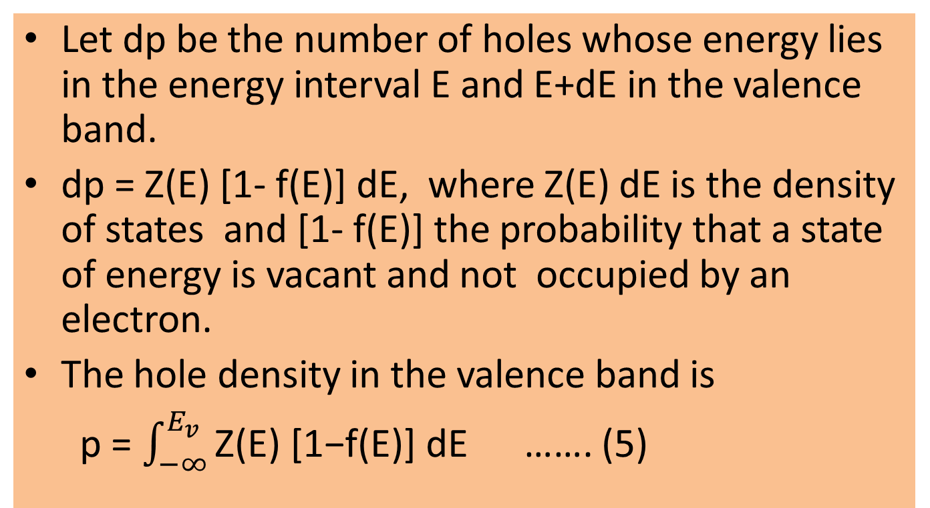
Intrinsic Semiconductor
Calculation of hole density

Slide 15
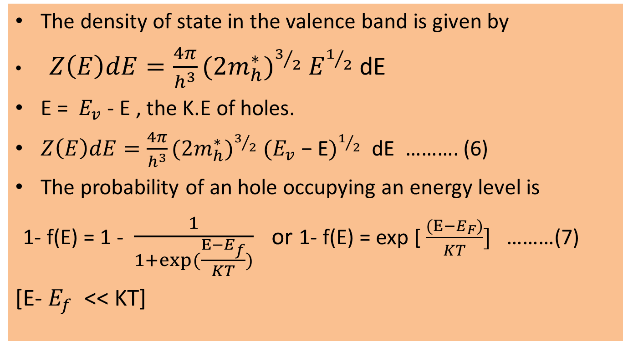
Intrinsic Semiconductor
Calculation of hole density

Slide 16
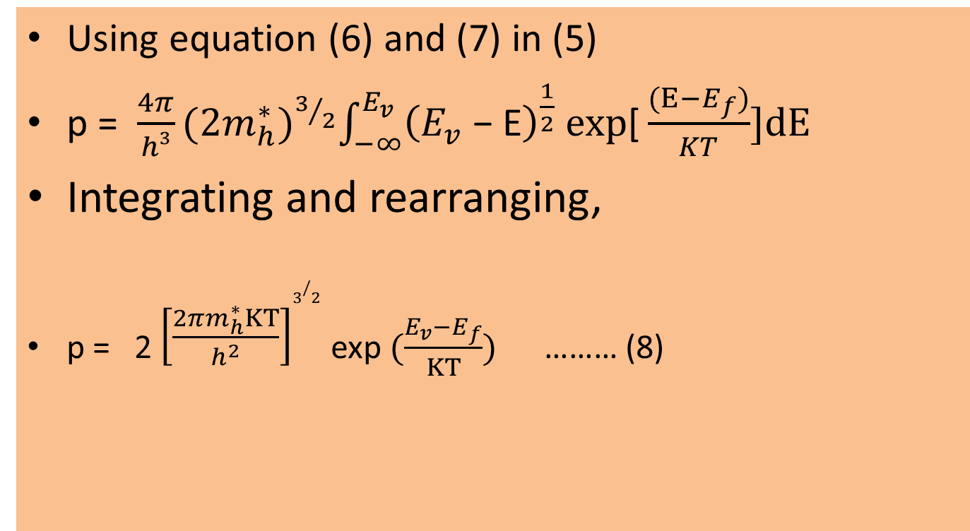
Intrinsic Semiconductor
Calculation of hole density

Slide 17
Intrinsic concentration
When a bond breaks in a pure semiconductor it leads to generation of an electron and hole pair.
At any temperature T, the number of electrons generated will be equal to the number of holes generated.
The number of electrons is equal to the number of holes i.e. n = p = n_{i}
n_{i} is called as intrinsic density or intrinsic concentration.

Slide 18
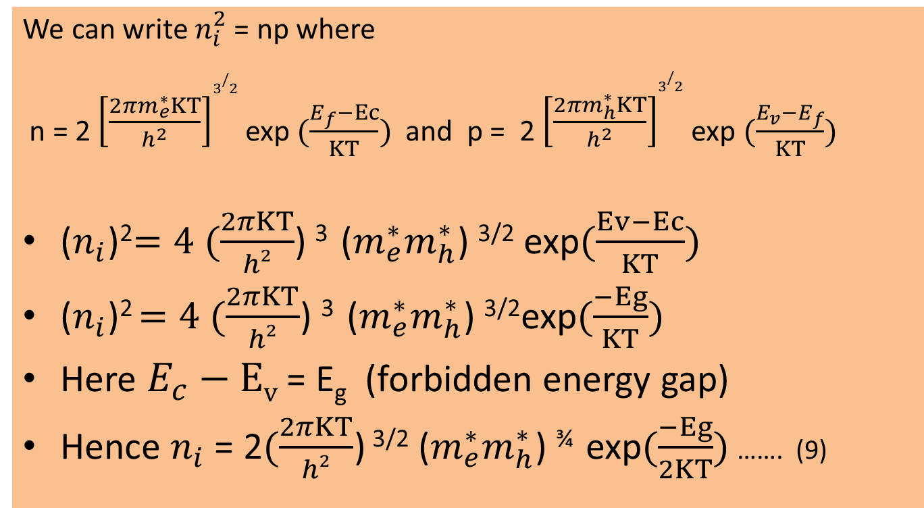
Intrinsic concentration

Slide 19
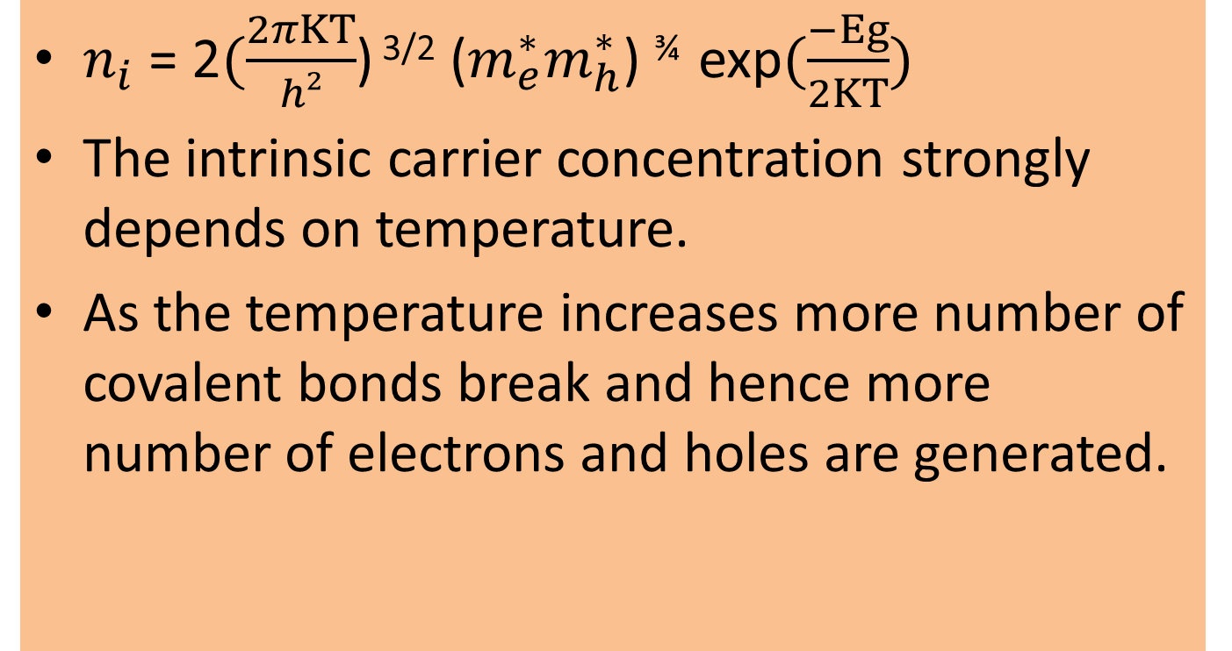
Intrinsic concentration - dependence on temperature

Slide 20
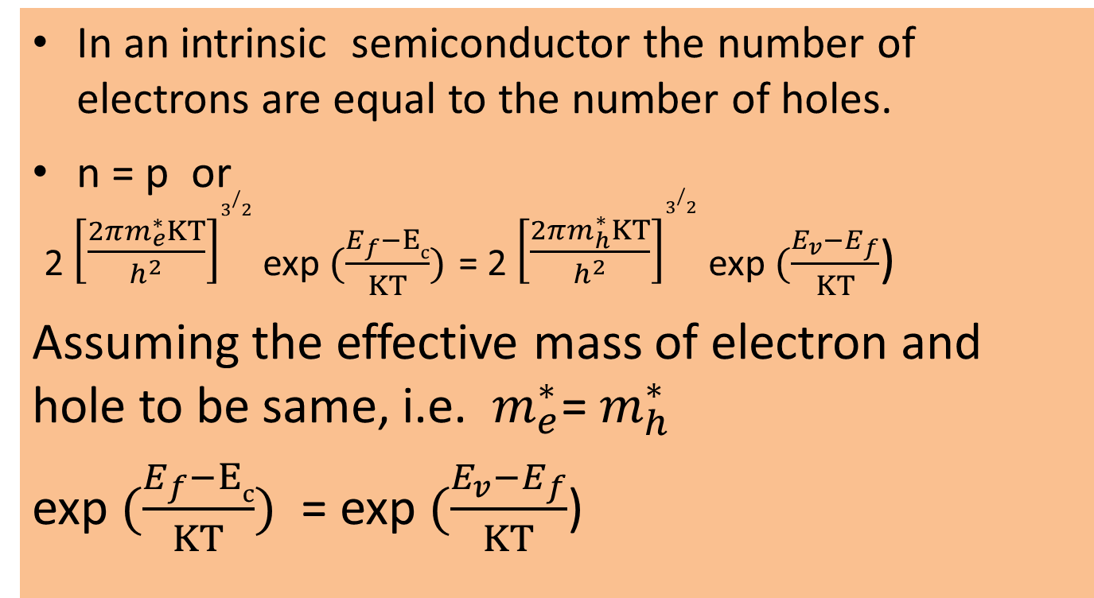
Intrinsic concentration – Fermi level

Slide 21
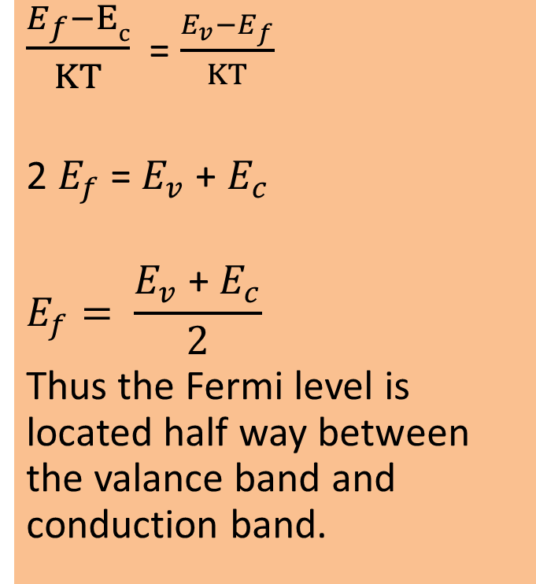
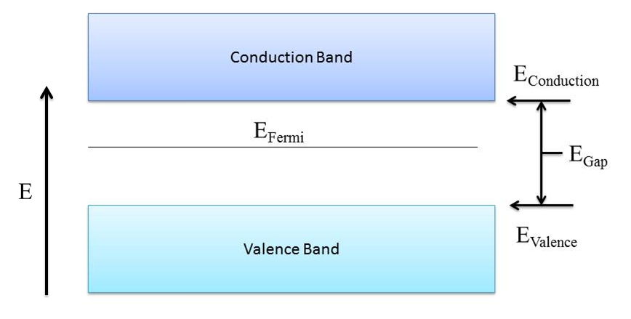
Intrinsic concentration – Fermi level

Slide 22
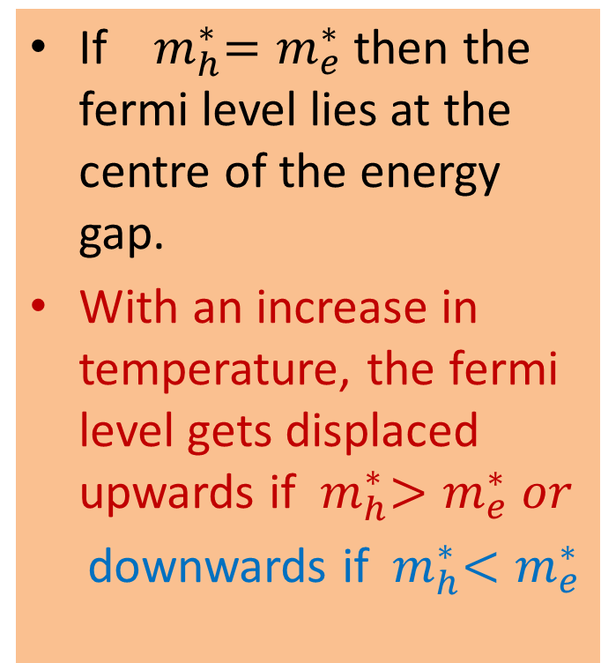
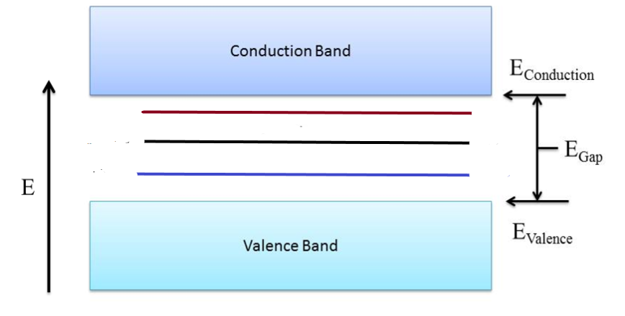
Variation of Fermi level with temperature in an intrinsic semiconductor

Slide 23
Extrinsic Semiconductor
Carrier concentration in n type semiconductors
Let N_{d} be the concentration of donors in the material. At 0 K, the donor atoms are not ionized and are at the level E_{d.}
At temperature above 0 K, the donor atoms get ionized and free electrons jump to conduction band.

Slide 24
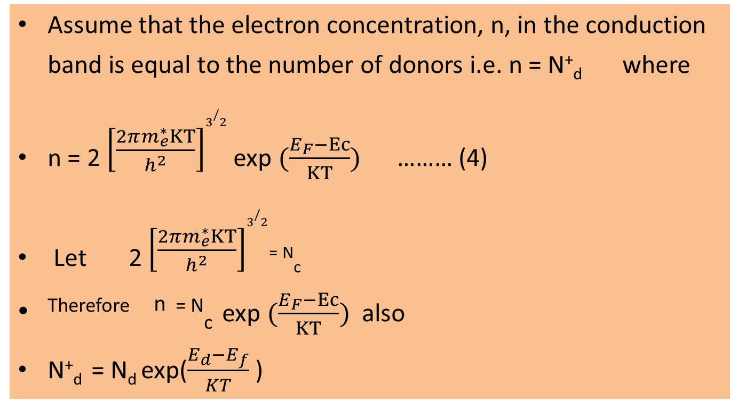
Extrinsic Semiconductor
Carrier concentration in n type semiconductors

Slide 25
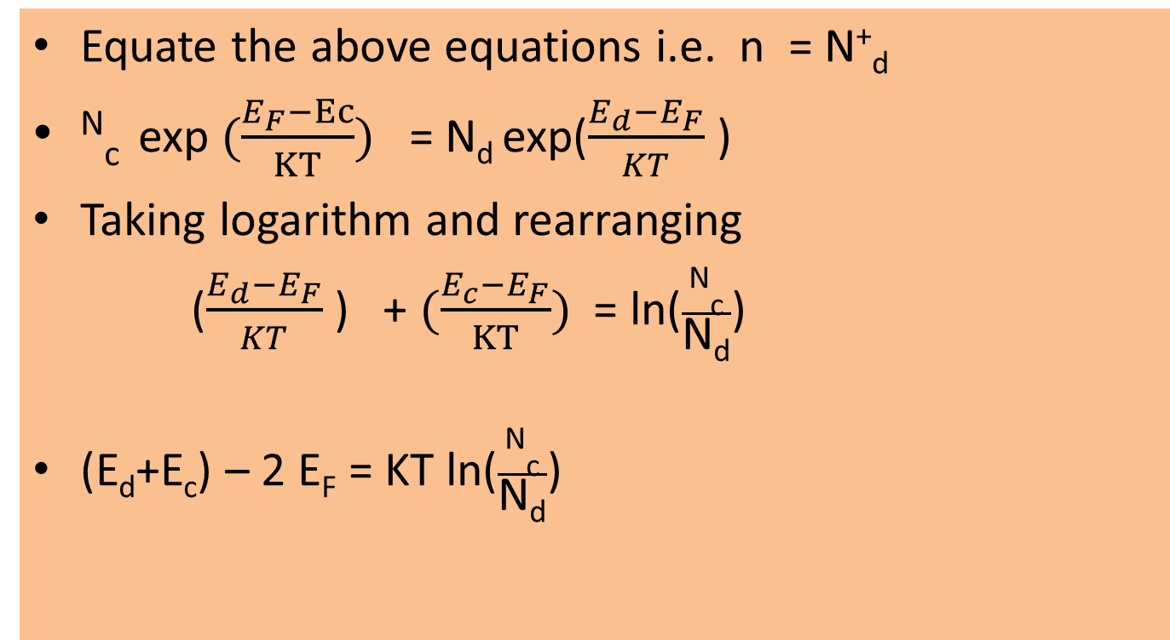
Extrinsic Semiconductor
Carrier concentration in n type semiconductors

Slide 26
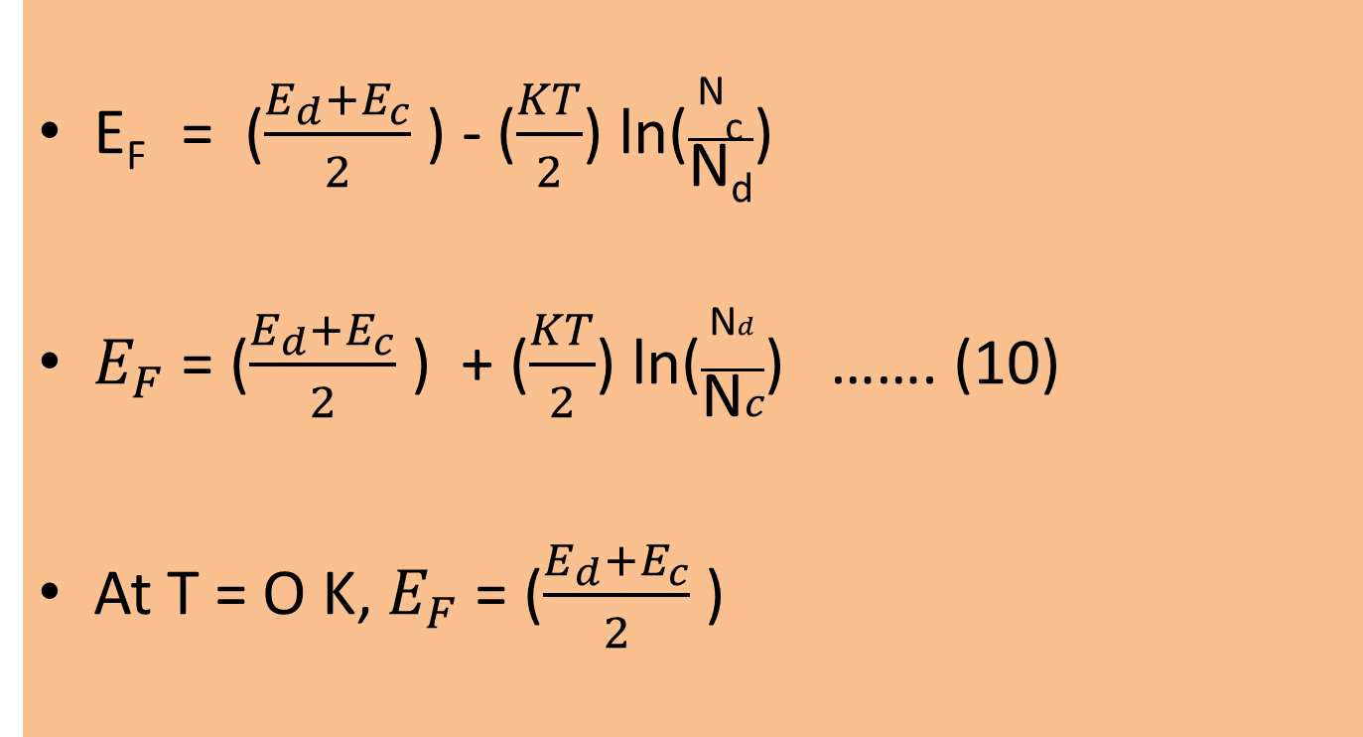
Extrinsic Semiconductor
Carrier concentration in n type semiconductors

Slide 27
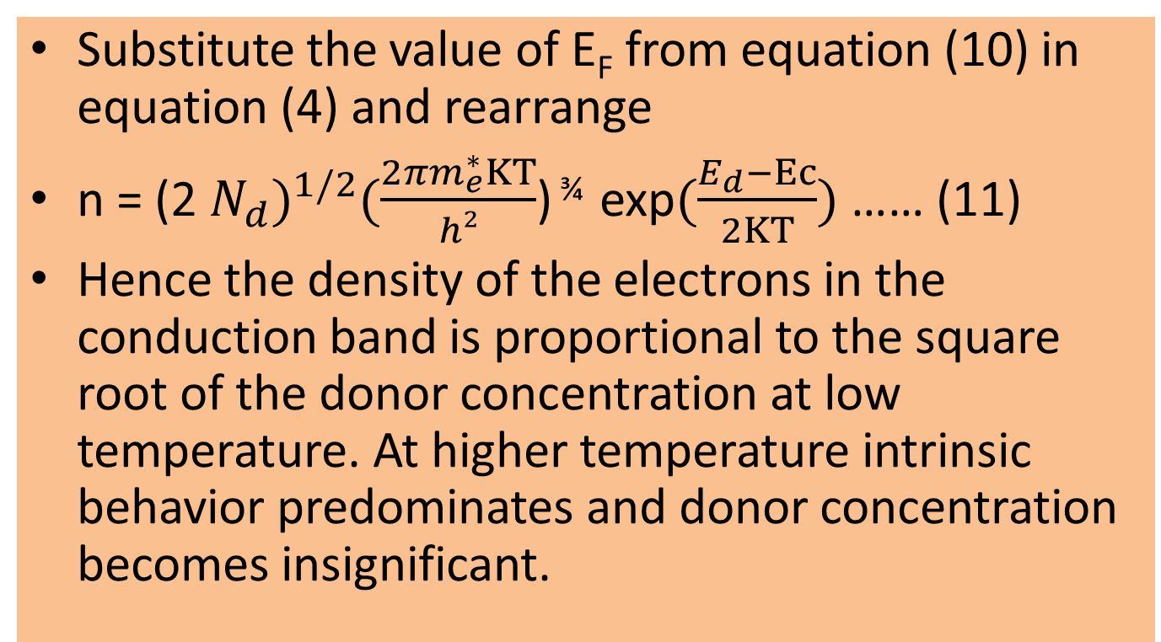
Extrinsic Semiconductor
Carrier concentration in n type semiconductors

Slide 28
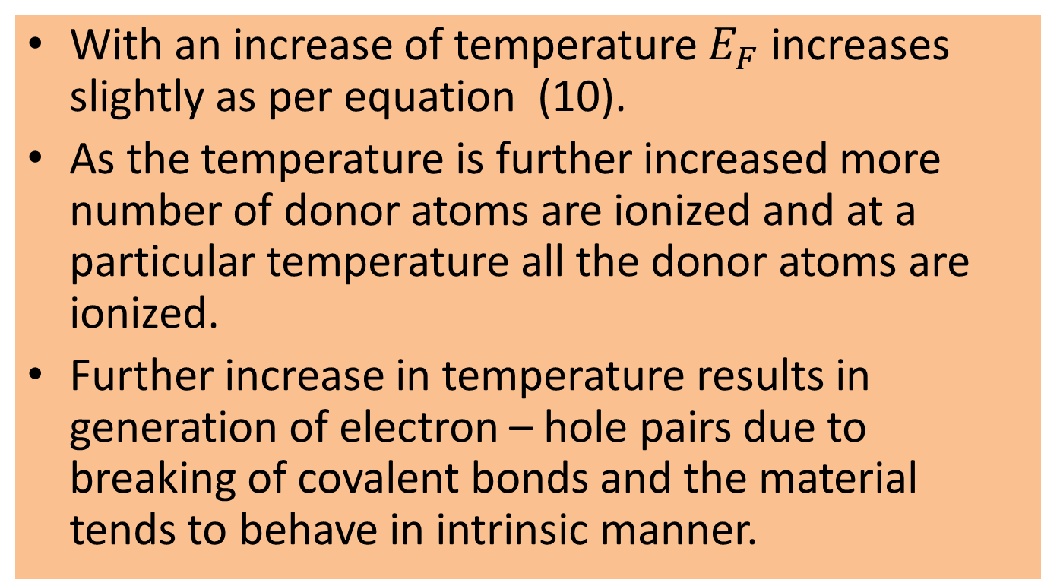
Variation of Fermi level with temperature

Slide 29
Extrinsic Semiconductor
Carrier concentration in p type semiconductors
Let N_{a} be the concentration of acceptors in the material. At 0 K, the acceptor atoms are not ionized and are at the level E_{a.}
At temperature above 0 K, the acceptor atoms get ionized and holes appear in the valence band.

Slide 30
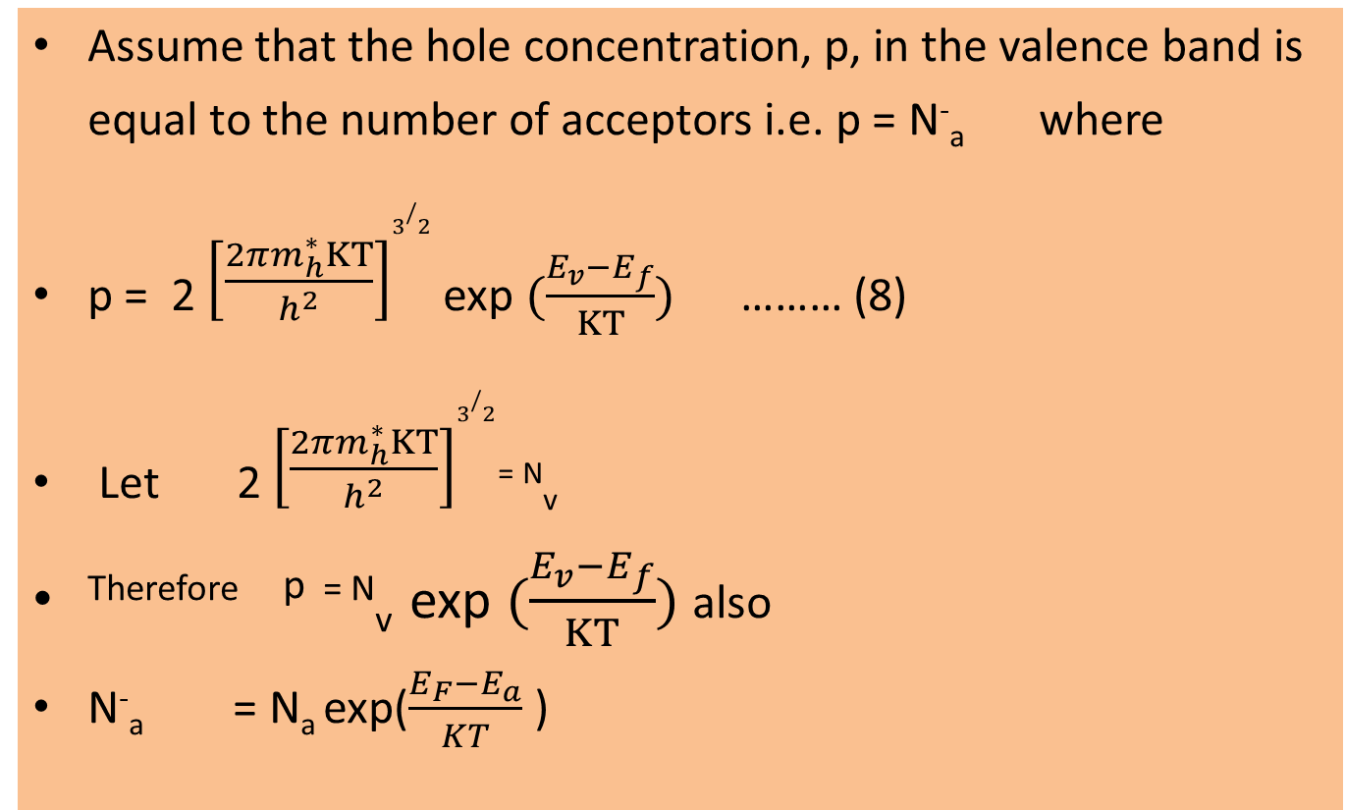
Extrinsic Semiconductor
Carrier concentration in p type semiconductors

Slide 31
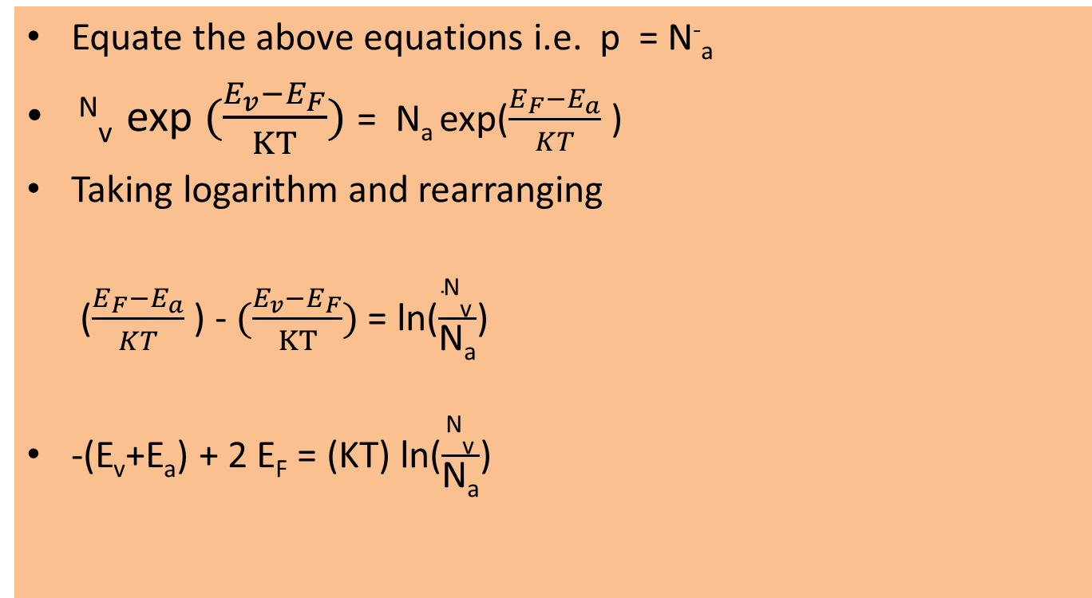
Extrinsic Semiconductor
Carrier concentration in p type semiconductors

Slide 32
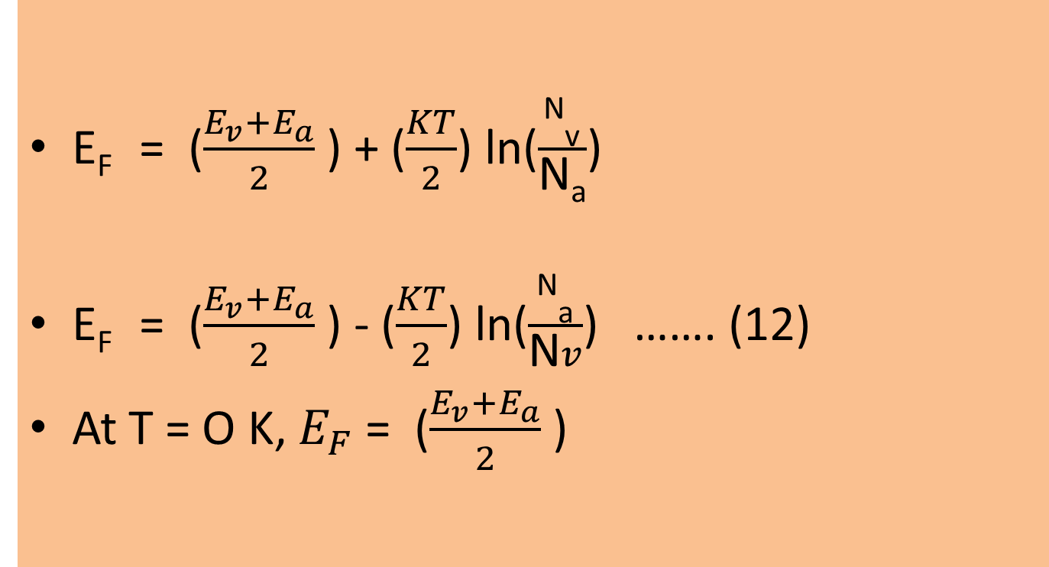
Extrinsic Semiconductor
Carrier concentration in p type semiconductors

Slide 33
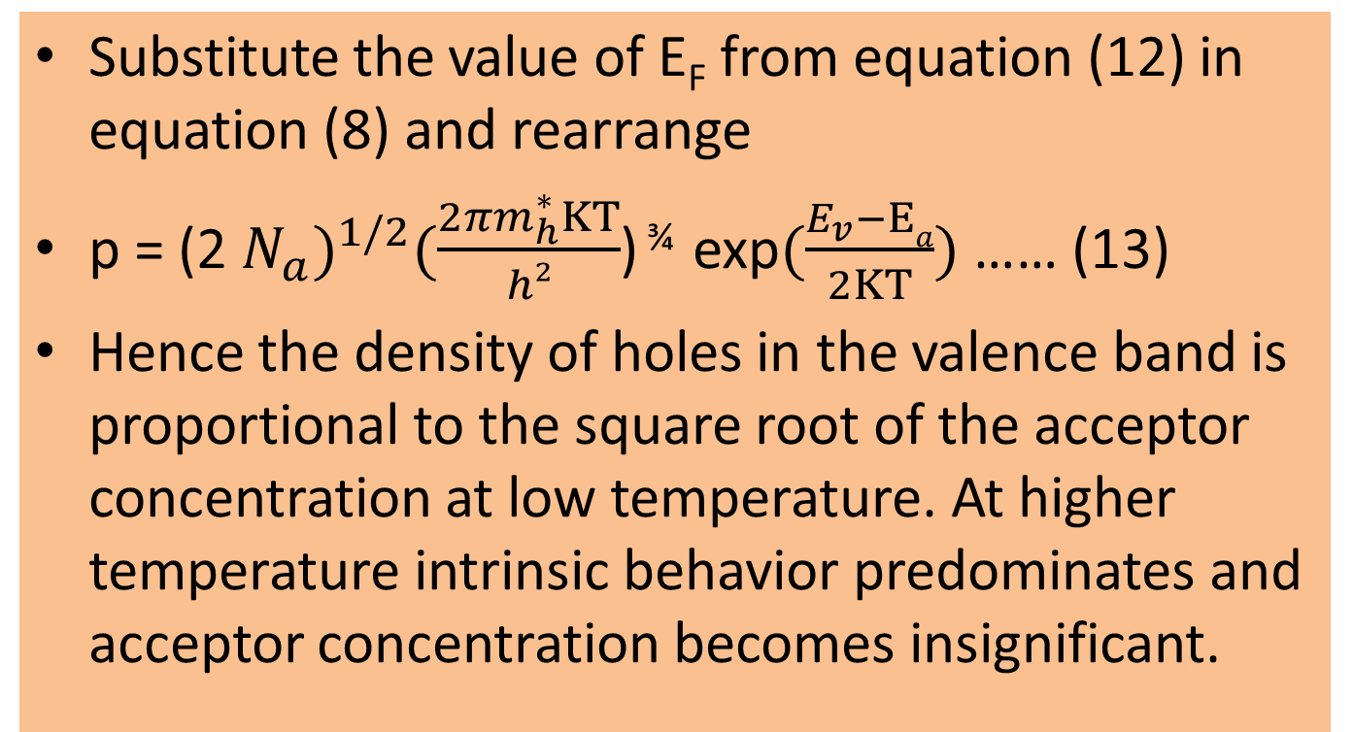
Extrinsic Semiconductor
Carrier concentration in p type semiconductors

Slide 34
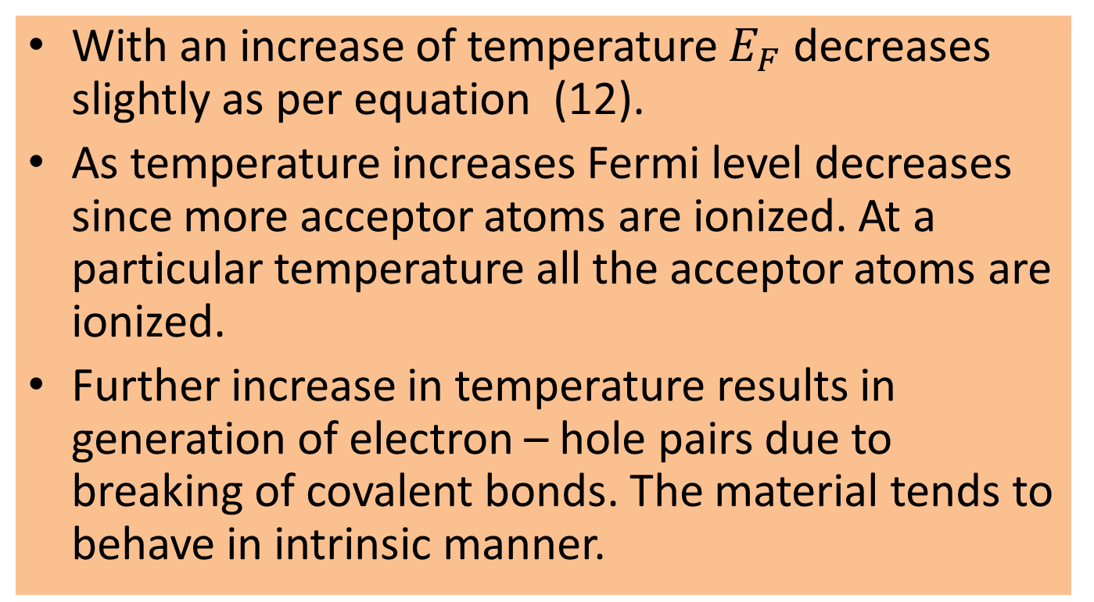
Variation of Fermi level with temperature

Slide 35
Generation and Recombination
When sufficient energy in the form of thermal energy or optical illumination is given to the semiconducting material, covalent bonds are broken and a pair of electron and hole is generated.
The electrons are raised from valence band to conduction band. Holes remain in the valence band.
The process of generation can occur only when the energy given to the semiconducting material is greater than its forbidden energy gap.
The electrons move in the conduction band and holes in the valence band. Their motion is a random motion.
The number of electrons is equal to the number of holes.

Slide 36
Generation and Recombination
When an electron in the conduction band collides with other particles, it looses energy and falls to the valence band. In the valence band the electron combines with a hole and in the process energy is released.
Recombination is the process where an electron from the conduction band recombines with a hole in the valence band. This is called band to band recombination and in the process a photon is released.

Slide 37
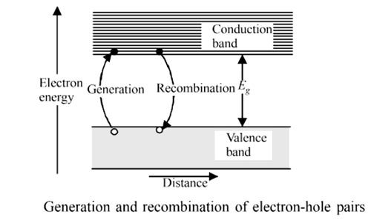
Generation and Recombination
At a steady temperature a dynamic equilibrium exists which balances the two processes of electron-hole pair generation and electron-hole recombination

Slide 38
Drift Current
Under the condition of thermal equilibrium, the electrons and holes are uniformly distributed in a crystal and when no external field is applied current does not flow in the crystal.
Drift current: When an electric field E is applied to a semiconductor, the charge carriers(electrons and holes) start to move and produce drift current.

Slide 39
Drift Current
The electrons drifting in the conduction band produce a current component J_{e} given by
J_{e}(drift) = neµ_{e}E, where µ_{e} is the mobility of electrons.
The hole drifting in the valence band cause a current component J_{h} given by
J_{h}(drift) = peµ_{h}E, where µ_{h} is the mobility of holes.

Slide 40
Drift Current
The total drift current density is,
J (drift) = J_{e}(drift) + J_{h} (drift)
= e (nµ_{e}+ pµ_{h}) E
Although electrons and holes move in opposite directions, the direction of conventional current flow due to both the carriers is in the same direction.

Slide 41
Diffusion Current
Diffusion current: In semiconductors, current can also flow without the application of external electric field. The charge carriers(electrons and holes) diffuse from regions of high concentration to regions of low concentration until the charge carriers are evenly distributed in the material. This motion of charge carriers produce a current component known as diffusion current.

Slide 42
Diffusion Current
The current component due to electron diffusion is given by
J_{e}(diff) = e D_{e}
The current component due to hole diffusion is given by
J_{h}(diff) = - e D_{h}
D_{e}andD_{h} are diffusion coefficients for electrons and holes respectively
The total diffusion current is J = J_{e}(diff) + J_{h}(diff)
J = e D_{e} + (- e D_{h} )

Slide 43
Drift and Diffusion Current
The total current density due to drift and diffusion of electrons is
J_{e} = J_{e}(drift) + J_{e} (diffusion)
= e (nµ_{e} E + D_{e} )
For holes
J_{h} = J_{h}(drift) + J_{h} (diffusion)
= e (pµ_{h} E – D_{h} )

Slide 44
Hall Effect
When a piece of conductor (metal or semiconductor) carrying current is placed in a transverse (perpendicular) magnetic field, an electric field is produced inside the conductor in a direction normal to both the current and the magnetic field. This phenomenon is known as Hall Effect and the generated voltage is known as Hall voltage.

Slide 45
Hall Effect
If the material is a p type semiconductor, when electric and magnetic field is applied at right angle to each other, holes experience a force and are accumulated on one face of the material. This causes a potential difference and a voltage is developed called Hall voltage.
If the material is a n type semiconductor, when electric and magnetic field are applied at right angle to each other, electrons experience a force and are accumulated on one face of the material. This causes a potential difference and a voltage is developed called Hall voltage.

Slide 46
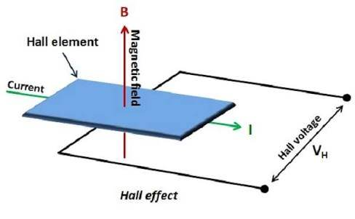
Hall Effect

Slide 47
Hall Effect
Consider a n type semiconductor in which electrons have a velocity “v” due to current flow. Let “B” be the applied magnetic field. The electrons experience a force of “Bev” due to the magnetic field.
This causes the electron current to be deflected causing a negative charge to accumulate on one face of the semiconductor.
A potential difference is established across the two faces of the material causing a field “E_{H} “. This field gives rise to a force “e E_{H} “ on the electrons.

Slide 48
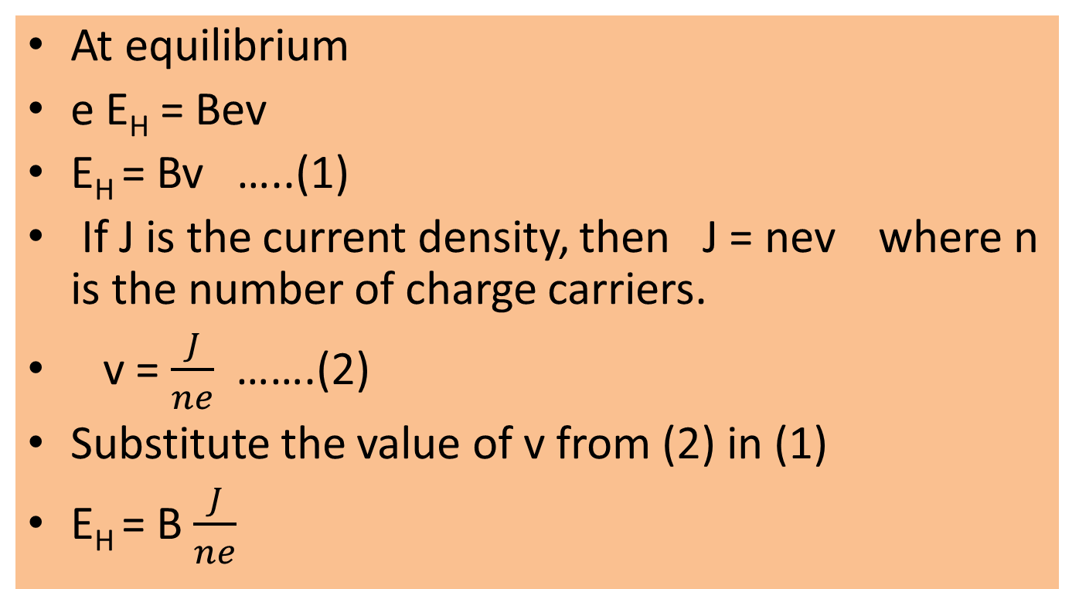
Hall Effect

Slide 49
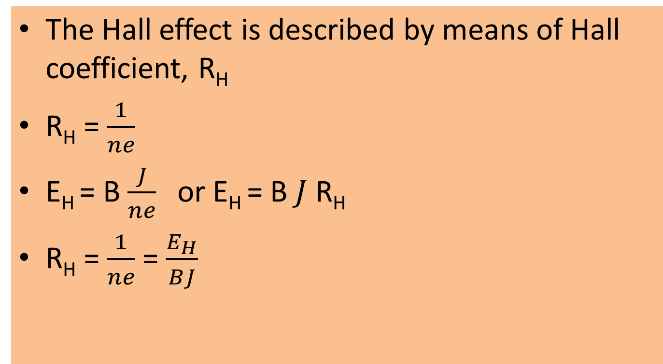
Hall Effect

Slide 50
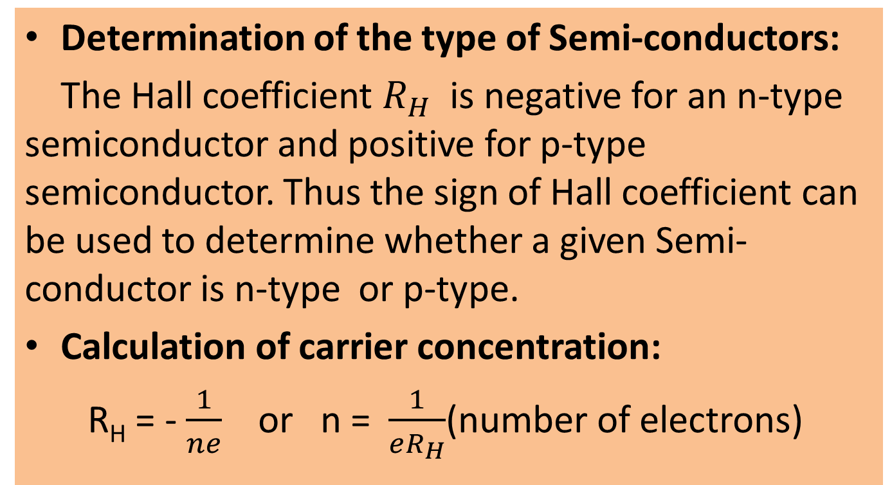
Hall Effect- Applications

Slide 51
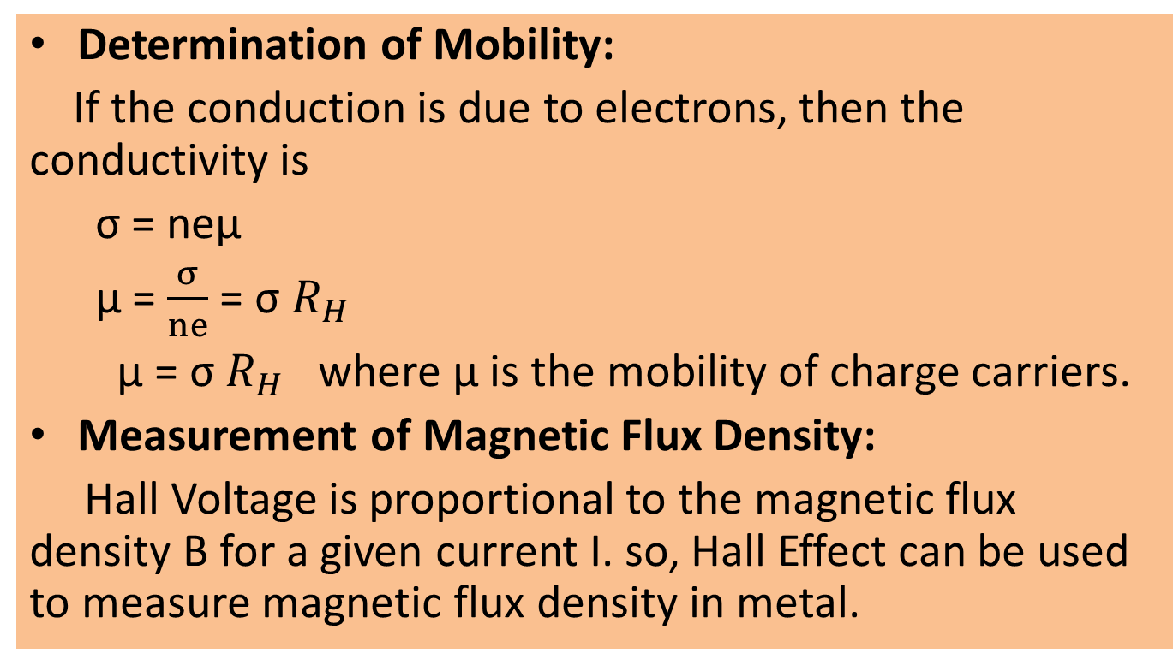
Hall Effect - Applications

Slide 52
pn Junction
A p-n junction is formed when a p- type and n- type semiconductor are joined through the process of crystal growth. Within the semiconductor the region where there is a transition from p- type to n- type is called a junction.
In p-type material holes are majority charge carriers and electrons are minority charge carriers.
In n-type material electrons are majority charge carriers and holes are minority charge carriers.

Slide 53
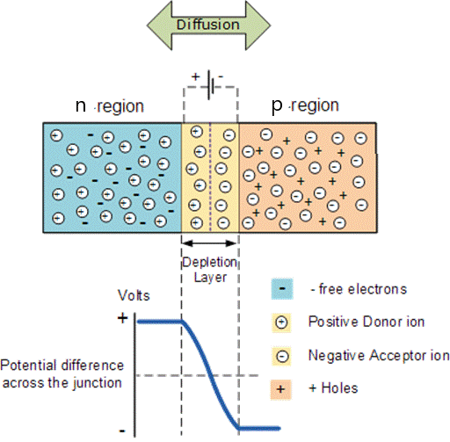
pn Junction

Slide 54
pn Junction
At the junction, holes diffuse from p region to n region and likewise electrons diffuse from n region to p region. The electrons and holes recombine and disappear at the junction region.
Around the junction region, free electrons and holes recombine and only immobile ions are present. This region is called space charge region. This region is also called depletion region.
The fixed ions in the depletion region produce electric field, E. This electric field opposes the further diffusion of electrons and holes from n-type region to p-type region. The electric field gives rise to a potential called potential barrier.
Further diffusion of electrons and holes across the potential barrier can only take place when they overcome the potential barrier.

Slide 55
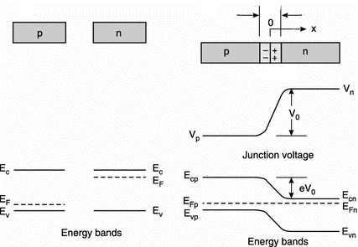
Energy level diagram

Slide 56
Energy level diagram
v_{o =} v_{n –} v_{p ,} where v_{o} is the contact potential or the barrier voltage.
V_{n} is the potential of depletion region on n side.
V_{p} is the potential of depletion region on p side.
Under unbiased condition no net current flows and fermi level is common on n side and p side.
The electric field is given by
E = E_{vp} – E_{vn} = E_{cp} – E_{cn} = e V_{o}

Slide 57
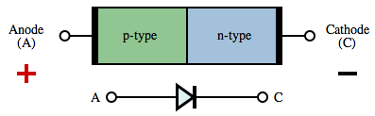
Circuit symbol of p-n junction diode

Slide 58
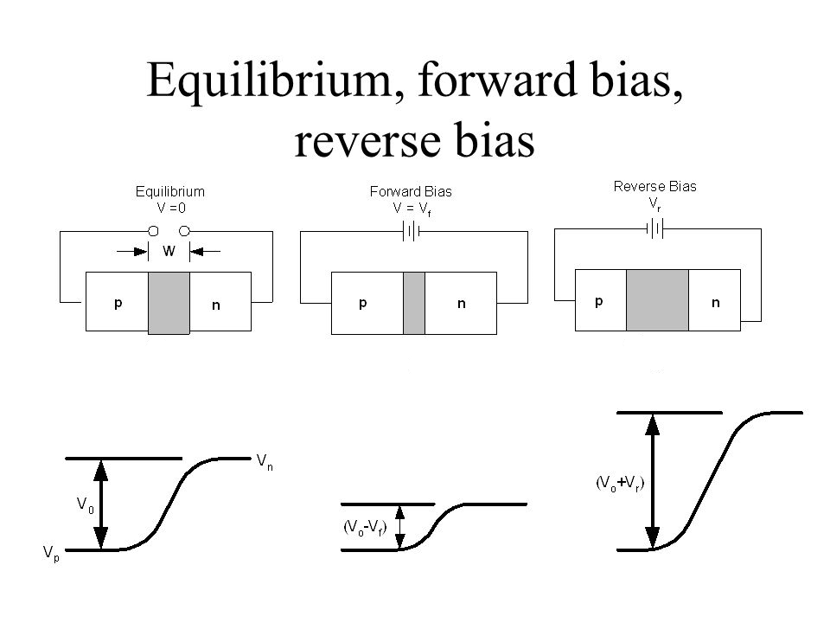
pn junction: I-V Characteristics

Slide 59
pn junction: I-V Characteristics
Unbiased circuit:
When the junction is not connected to any voltage source, it is said to be unbiased. Due to the presence of barrier potential across the junction, there is no flow of charge carriers and hence there is no current flow through the junction.
Forward biased circuit:
When the positive terminal of the source (battery) is connected to p region and negative terminal to n region, the junction is said to be forward biased.
Reverse biased circuit:
When the positive terminal of the source (battery) is connected to n region and negative terminal to p region, the junction is said to be reverse biased.

Slide 60
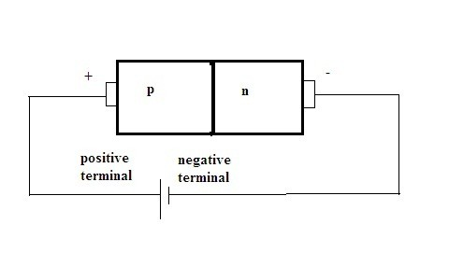
Pn Junction: Forward bias
When a dc voltage, V_{F} is connected to the diode in such a way that the positive terminal of the source is connected to the p-region and the negative terminal to the n-region, then the junction is forward biased.
The voltage across the junction decreases by an amount, V_{O} - V_{F}, where V_{O} is the barrier voltage.
The majority charge carriers move across the junction and hence the width of the depletion region decreases.

Slide 61
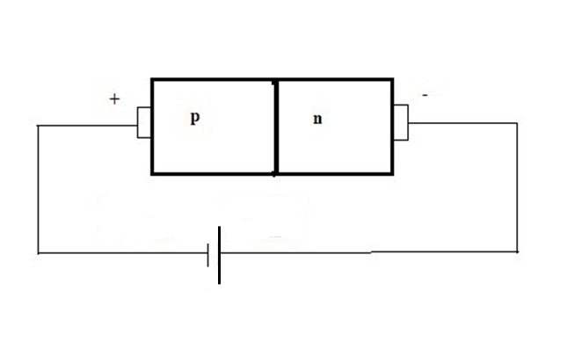
Pn Junction: Reverse bias
When a dc voltage, V_{R,} is connected to the diode in such a way that the positive terminal of the source is connected to the n-region and the negative terminal to the p-region, then the junction is reverse biased.
The voltage across the junction increases and is equal to, V_{O} + V_{R}, where V_{O} is the barrier voltage.
The majority charge carriers are pushed away from the junction and hence the width of the depletion region increases.
Minority charge carriers drift across the barrier and give rise to current.

Slide 62
pn junction: I-V Characteristics
A graph that shows the variation in current in a device with variation of voltage applied across it is called I-V Characteristics.
The I-V Characteristics of a pn junction is non linear.
The pn junction acts as a closed switch in forward bias condition allowing large current to flow through it, and acts as an open switch in reverse bias condition causing a very small amount of current to flow through it.

Slide 63
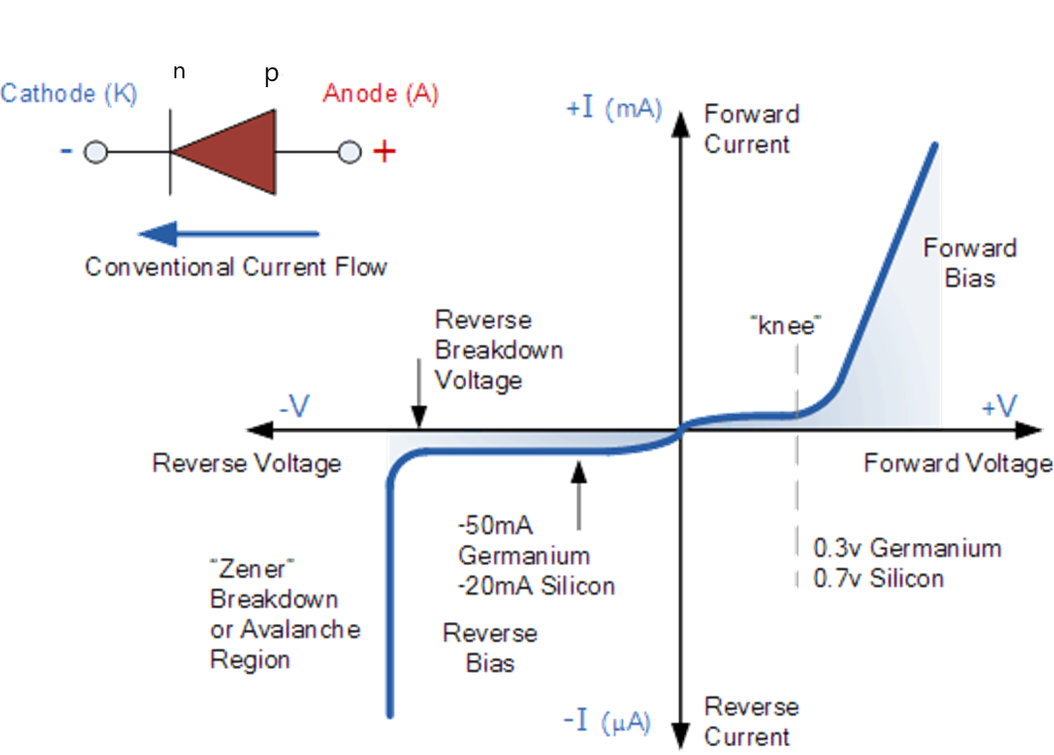
pn junction: I-V Characteristics

Slide 64
pn junction: I-V Characteristics
Forward bias:
As long as the forward bias voltage is less than the voltage across the potential barrier, the current through the junction is negligibly small.
The voltage at which the current increases sharply is called cut - in voltage or knee voltage.
As the forward voltage increases beyond the potential barrier voltage, there is an exponential increase in forward current. The current is in mA.
The knee voltage for germanium is 0.3 V and for silicon it is 0.7 V.

Slide 65
pn junction: I-V Characteristics
Reverse bias:
Under reverse bias condition a small reverse current (in µ A) flows across the junction due to minority charge carriers.
When the applied reverse voltage is high, it breaks the covalent bonds of the crystal and a large number of charge carriers are produced. Thus the current rises suddenly in the reverse direction. The reverse voltage at which the diode breaks down is called breakdown voltage or Zener voltage.
The diode break down may be due to Avalanche break down or due to Zener break down.
Avalanche break down occurs in diodes which are lightly doped.
Zener break down occurs in diodes which are thin and heavily doped.

Slide 66
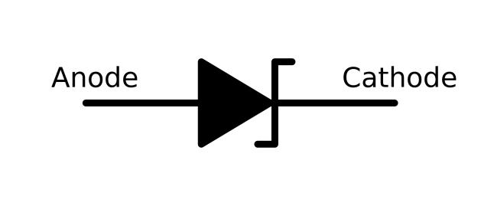
Zener diode: I-V Characteristics
Zener diode is a semiconductor diode specially designed to operate in the breakdown region of the reverse bias. Zener diodes are always operated in the reverse bias condition. The breakdown phenomenon is reversible and harmless.

Slide 67
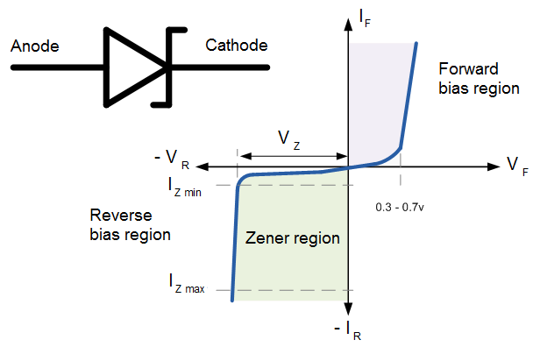
Zener diode: I-V Characteristics

Slide 68
Zener diode: I-V Characteristics
Zener diode acts similar to a ordinary diode under forward bias condition.
In reverse bias condition, as the reverse voltage is increased a small amount of current called leakage current flows. Leakage current is due to minority charge carriers.
At a particular value of reverse voltage, the current increases suddenly. This voltage is called breakdown voltage or Zener voltage, V_{Z}.
In ordinary diodes the breakdown voltage is high and if reverse current is allowed to flow, then the diode will be damaged.
Zener diodes are designed so that their Zener voltage is much lower, about 2.4 volts.

Slide 69
Zener diode: I-V Characteristics
When a reverse voltage above the Zener voltage is applied to a Zener diode, there is a controlled breakdown which does not damage the diode.
In the Zener region the voltage across the Zener diode remains constant but the current changes depending on the supply voltage.
The location of Zener region can be controlled by varying doping levels. An increase in doping will decrease the Zener potential.

Slide 70
Transistors
A transistor is a semiconductor device consisting of three regions i.e. the emitter, base and collector. The three regions are separated by two p-n junctions.
Transistors are of two types i.e. npn and pnp.
Electrons and holes are involved in current flow through an npn or pnp transistor and hence are called bipolar junction transistor.

Slide 71
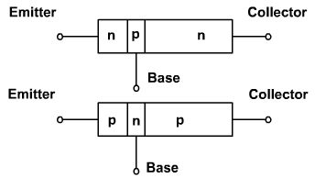
Transistors
Emitter is heavily doped. It injects electrons into the base(npn transistor).
Base is lightly doped and thin.
Collector doping is between heavy doping of emitter and light doping of base

Slide 72
Transistors
Collector collects electrons from base in npn transistor. It dissipates a lot of heat and hence is largest of the three regions in size.
The base is very thin in size.
The transistor has two junctions.
One junction between emitter and the base(EB junction) and other between the base and the collector(CB junction).

Slide 73
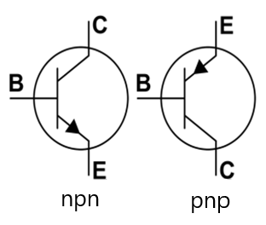
Representation of transistor
The arrow in the representation is between the base and emitter. The direction of the arrow is the direction of flow of conventional current.
Conventional current direction is opposite to the direction of flow of electrons.
In npn transistor, the arrow points from base to emitter.
In pnp transistor, the arrow points from emitter to base

Slide 74
Biasing a transistor
EB junction | CB junction | Region
FB | FB | Saturation region
RB | RB | Cut-off region
RB | FB | Inverted mode
FB | RB | Active region or normal mode

Slide 75
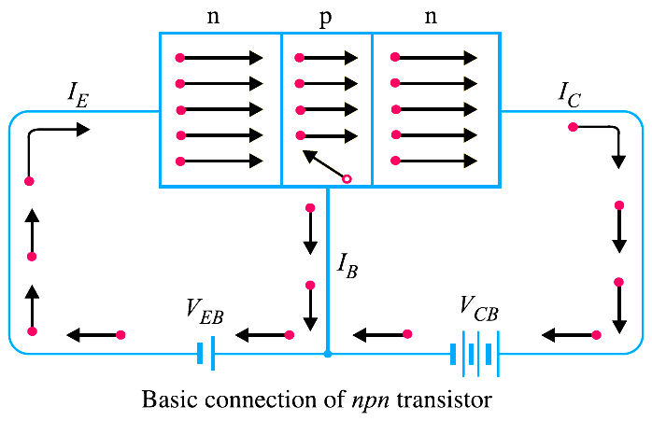
Working of CB npn transistor
The emitter-base junction of a transistor is forward biased whereas collector-base junction is reverse biased (normal mode).
Emitter is heavily doped
Forward bias voltage (V_{EB} )is small as compared to the reverse bias voltage( V_{CB} ).
The forward bias causes the electrons in the n-type emitter to flow towards the base. This constitutes the emitter current I_{E}.

Slide 76
Working of CB npn transistor
As these electrons flow through the p-type base, they tend to combine with holes. As the base is lightly doped and very thin, therefore, only a few electrons (less than 5%) combine with holes to constitute base current I_{B}.
The electrons which combine with holes become valence electrons. These valence electrons flow down through holes and into the external base lead. This constitutes base current I_{B}

Slide 77
Working of CB npn transistor
The remainder (more than 95%) cross over into the collector region to constitute collector current I_{C}. In this way, almost the entire emitter current flows in the collector circuit.
The emitter current is the sum of collector and base currents i.e. I_{E} = I_{B} + I_{C}

Slide 78
Working of CB npn transistor
Large amount of heat is produced in the collector and hence to dissipate heat the collector region is made large.
The ratio of number of electrons arriving at the collector to the number of electrons emitted by the emitter is called the base transportation factor, denoted by 'β'. Typically it is around 0.995

Slide 79
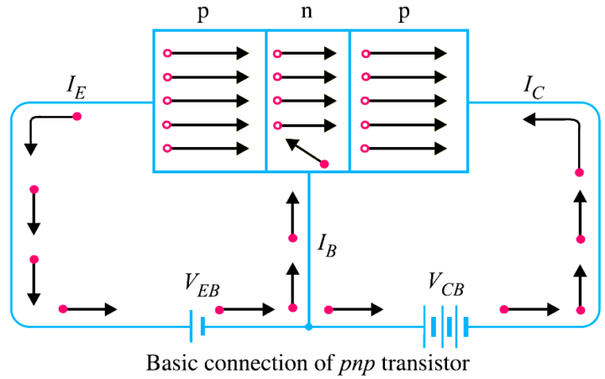
Working of CB pnp transistor
The emitter-base junction of a transistor is forward biased whereas collector-base junction is reverse biased (normal mode).
Emitter is heavily doped
Forward bias voltage (V_{EB} )is small as compared to the reverse bias voltage( V_{CB} ).
When forward bias is applied across the heavily doped emitter, the majority charge carriers (holes) move towards the base. This causes the emitter current I_{E}.

Slide 80
Working of CB pnp transistor
The holes enter into the base( n-type material) and combine with the electrons.
The base is lightly doped, due to which only a few holes(less than 5%) combine with electrons in the base.
The remainder (more than 95%) cross into the collector region to constitute collector current I_{C}. In this way, almost the entire emitter current flows in the collector circuit.

Slide 81
Working of CB pnp transistor
The reversed bias potential of the collector region causes high attractive force on the holes reaching collector junction. Thus the holes are attracted or collected at the collector.
Current conduction within pnp transistor is by holes. However, in the external connecting wires, the current is still by electrons.
I_{E} = I_{B} + I_{C}

